Slide 1

Spring Boot

Slide 2
Spring Framework and Spring Boot
Spring Framework
An open source java framework and inversion of control container. The framework was initially created as an alternative to EJB.
Spring Boot
Open source Java framework used to create a micro service feature to the Spring framework. Used to create standalone server side web API.

Slide 3
Architecture

Slide 4
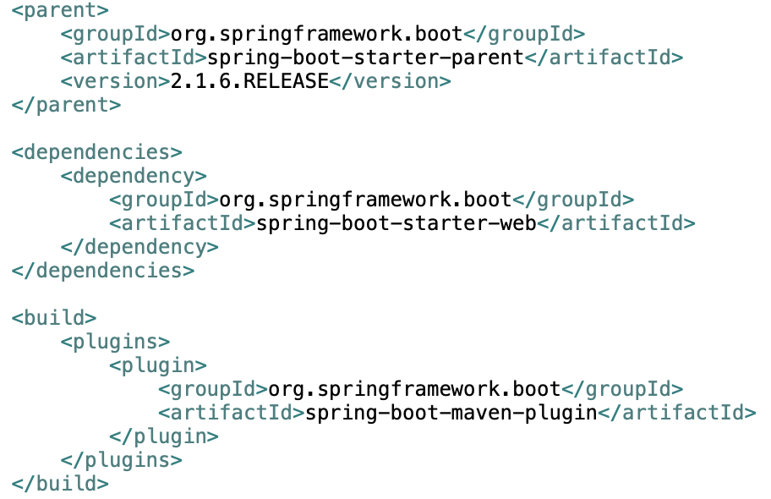
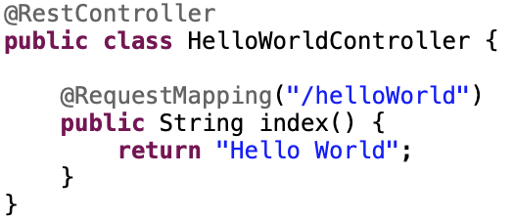
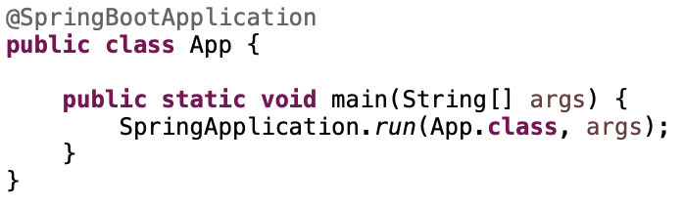
Hello World
pom.xml declaration
Create Controller
Create Application Class

Slide 5
IoC and DI
Inversion of Control (IoC) is a programming technique in which object coupling is bound at run time by an assembler object and is typically not known at compile time using static analysis.
Dependency Injection (DI) is a pattern used to create instances of objects that other objects rely on without knowing at compile time which class will be used to provide that functionality.
IoC relies on dependency injection because a mechanism is needed in order to activate the components providing the specific functionality

Slide 6
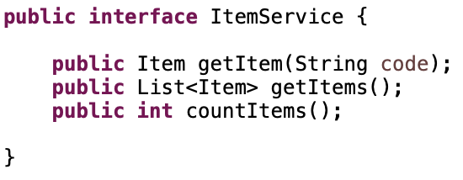
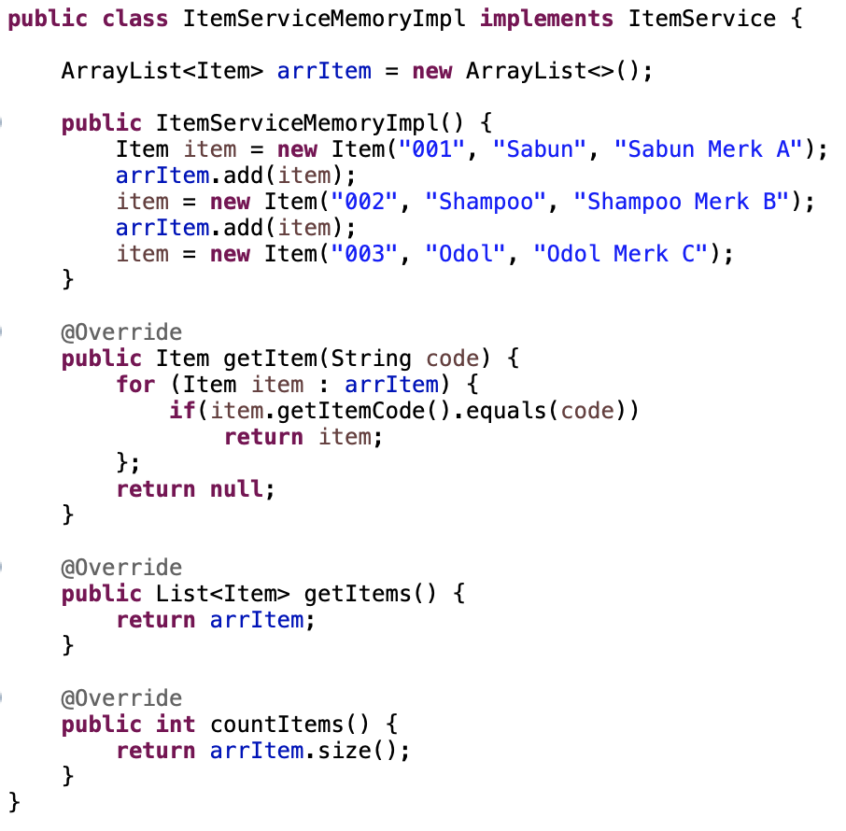
IoC and DI
Create Bean Class
Bean Declaration
DI Autowiring

Slide 7
Bean Scope
Singleton (default)
This scopes the bean definition to a single instance per Spring IoC container (default).
Prototype
This scopes a single bean definition to have any number of object instances.
request
This scopes a bean definition to an HTTP request. Only valid in the context of a web-aware Spring ApplicationContext.
session
This scopes a bean definition to an HTTP session. Only valid in the context of a web-aware Spring ApplicationContext.
global-session
This scopes a bean definition to a global HTTP session. Only valid in the context of a web-aware Spring ApplicationContext.

Slide 8
Request Mapping
HTTP Method
GET
POST
PUT/PATCH
DELETE
HEAD
OPTIONS
TRACE
Define Request HTTP Method to handle

Slide 9
Request Mapping
Parameter
Path Parameter
http://localhost:8080/pathVar/Joe
Request Body
curl -i \
-H "Accept: application/json" \
-H "Content-Type:application/json" \
-X POST --data '{"username": "johnny", "password": "password"}’ \
"http://localhost:8080/reqBody"
Query String Parameter
http://localhost:8080/queryStringVar?var=Joe

Slide 10
REST

Slide 11
JSON

